Slide 1
Disease Detection in Plants
Under Supervision of Dr. Manish Kumar

Slide 2
TABLE OF CONTENTS
01
02
03
04
05
06
Introduction
Problem Statement
Proposed Methodology
Data Analysis
Results
Conclusion

Slide 3
01
INTRODUCTION

Slide 4
Agriculture is essential to the global economy, providing food, fiber, and fuel to the growing population.
The agricultural sector is facing challenges such as climate change, soil degradation, and plant diseases.
Plant diseases can cause significant losses in crop yield and quality, leading to economic losses and food insecurity.
Early detection and prevention of plant diseases are crucial for sustainable agriculture.
Traditional disease detection methods rely on visual inspection, which is time-consuming and subjective.
Technological advancements have led to the development of automated systems for disease detection in plants.
These systems use machine learning algorithms and image processing techniques to accurately identify diseases in plants.
Automated disease detection enables early intervention and effective management of plant diseases.

Slide 5
02
PROBLEM STATEMENT

Slide 6
The problem addressed in this project is the need for an efficient and reliable tool to detect plant diseases in order to prevent significant crop losses.
Traditional methods of detecting plant diseases are time-consuming, expensive, and require expert knowledge. However, with advances in machine learning (ML) technology, it is now possible to automate the process of detecting plant diseases using image processing techniques.
The objective of this project is to develop and apply an ML model that can accurately detect plant diseases from images of plant leaves. The model should be able to classify the type of disease and provide recommendations for appropriate treatment.
This project aims to contribute to the development of a cost-effective, efficient, and reliable tool for detecting plant diseases, which can help farmers to make informed decisions and prevent significant crop losses.

Slide 7
03
PROPOSED METHODOLOGY

Slide 8
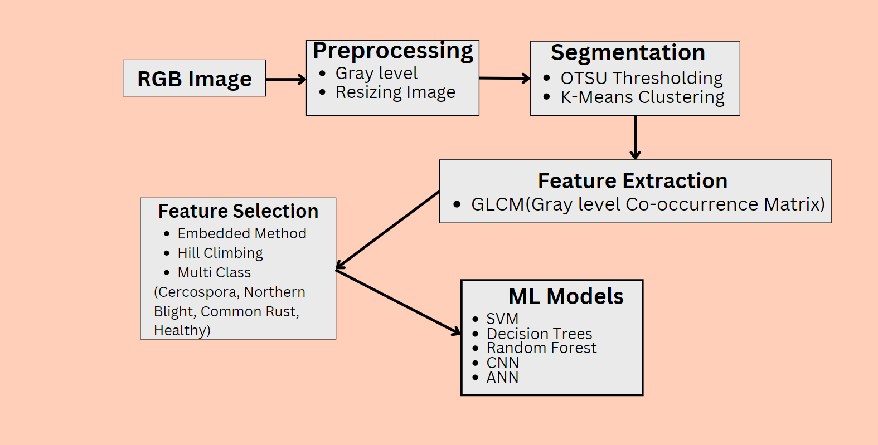

Slide 9
04
DATA ANALYSIS

Slide 10
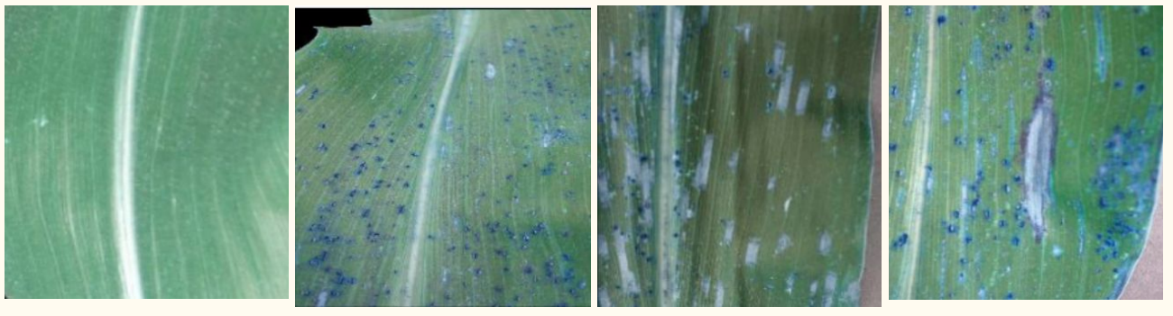
Dataset Details :
We are using the plant village dataset of maize plant which has around 3848 images.
Healthy(1161) Common_rust(1191) Cercospora(512) Northan_Blight(984)

Slide 11

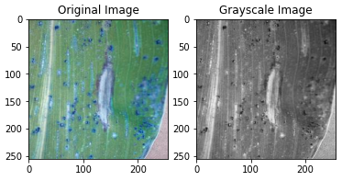
Preprocessing :
Preprocessing on RGB image which involves steps like -
Resizing of image dataset (256 X 256).
Converting RGB image to Gray-scale image.
Applied Gaussian Blur.

Slide 12
Segmentation Techniques :
01
02
Segmentation of features which are relevant to our study using -
Otsu Thresholding
K-Means Clustering

Slide 13
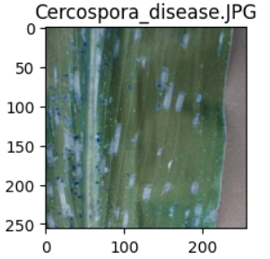

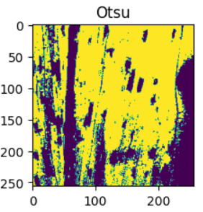
Otsu Thresholding :
Otsu Thresholding is method to determine optimal threshold value for separating an image into foreground and background regions.
The threshold value t* selected by Otsu's method is the value of t that maximizes the between-class variance of the pixel intensities.
In case of Cercospora Disease, optimal threshold value is 111.

Slide 14
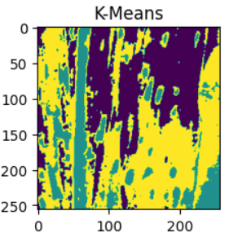
K-Means Clustering :
The main idea behind K-means is to partition a given dataset into K clusters, where K is a pre-defined number of clusters.
The algorithm iteratively assigns each data point to the cluster whose centroid (mean) is closest to the data point, and
Then updates the centroid of each cluster based on the data points that belong to it.
In our case, we are taking k = 3.

Slide 15
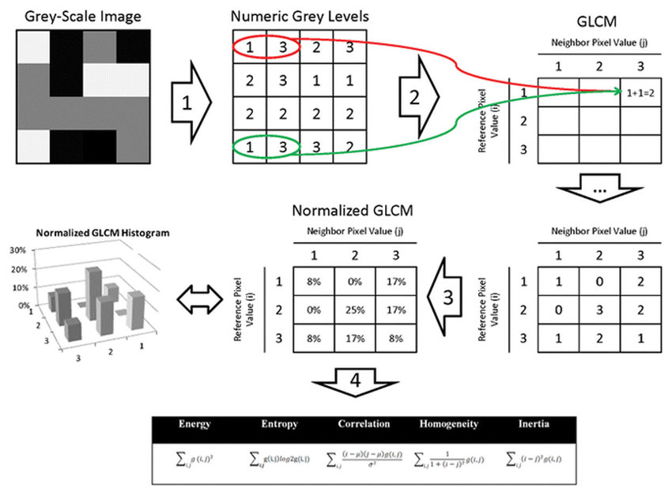
Feature Extraction :
Extraction of features is done using GLCM (Gray Level Co-occurrence) matrix.
The Gray-Level Co-occurrence Matrix (GLCM) is a statistical method used in image processing to analyze texture information.
GLCM matrix summarizes the frequency of occurrence of pairs of pixel intensities at different spatial relationships, which can be used to derive various texture features such as contrast, correlation, energy, and homogeneity.

Slide 16
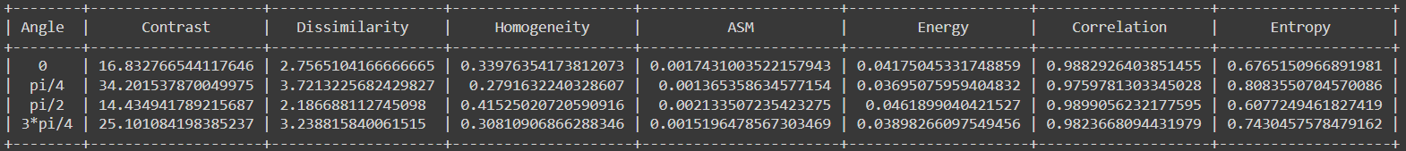
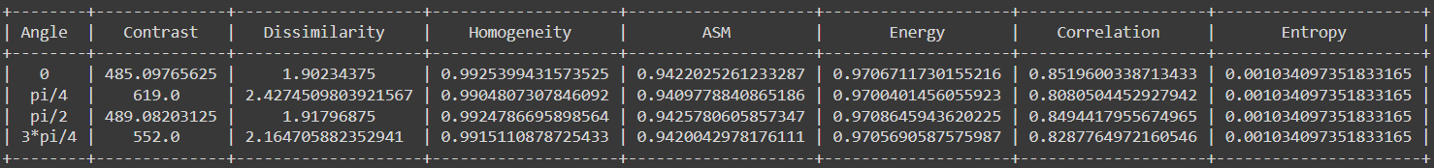
GLCM matrix of pre-processed image
GLCM Matrix for Preprocessed Image (Common Rust) :
GLCM Matrix for Otsu Thresholding :

Slide 17
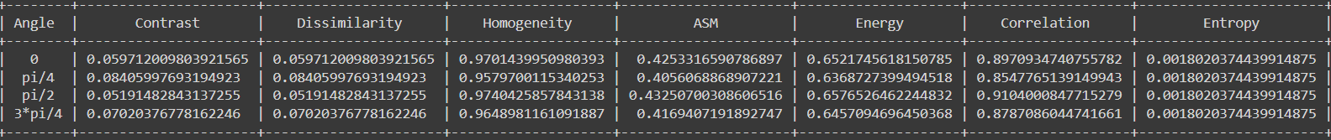
GLCM matrix of pre-processed image
GLCM Matrix for Preprocessed Image (Common Rust) :
GLCM Matrix for K-Means Clustering Image :

Slide 18
Feature Selection
01
02
Selection of Relevant Features on the basis of Importance value :
Embedded Methods (Random Forest)
Hill Climbing

Slide 19

Feature Selection using Random Forest
The main idea behind feature selection using Random Forest is to measure the importance of each feature in the model.
Random Forest builds a large number of decision trees on randomly selected samples of the dataset, and each tree is trained on a random subset of features.
The final prediction is then made by averaging the predictions of all the trees.
By selecting only the most important features, we can reduce the dimensionality of the dataset, which can lead to faster training times and better model performance.

Slide 20
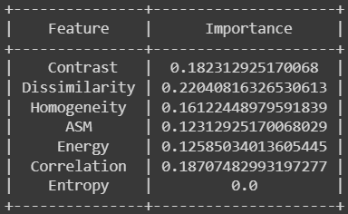
Feature Selection using Random Forest (Results)
Selected Features for Common Rust Leaf using Random Forest along with its importance value.

Slide 21
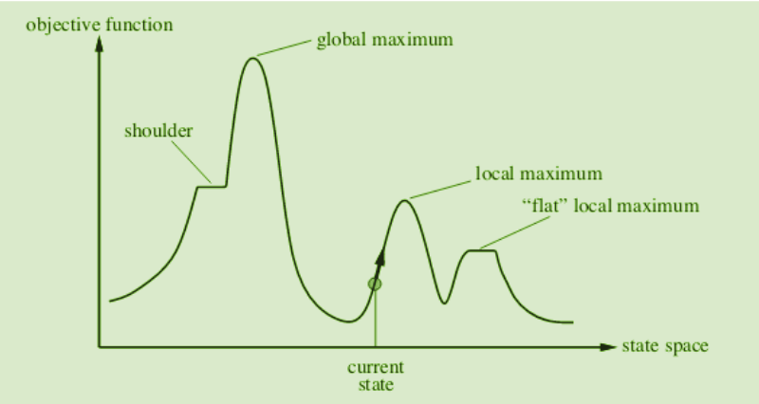
Feature Selection using Hill Climbing
The main idea behind feature selection using Hill Climbing is to start with an initial subset of features and iteratively add or remove features to improve the performance of the model.
The algorithm starts with an initial subset of features, and evaluates the performance of the model using only those features.
Then, it generates a set of candidate feature subsets by adding or removing one feature at a time. It selects the feature subset that gives the best performance, and repeats this process until no further improvements can be made.

Slide 22
Feature Selection using Hill Climbing (Results)
Selected Features for Common Rust Leaf using Hill Climbing.
Selected features:
['dissimilarity_angle_3', 'energy_angle_3', 'contrast_angle_1', 'dissimilarity_angle_2', 'homogeneity_angle_3', 'contrast_angle_2']

Slide 23
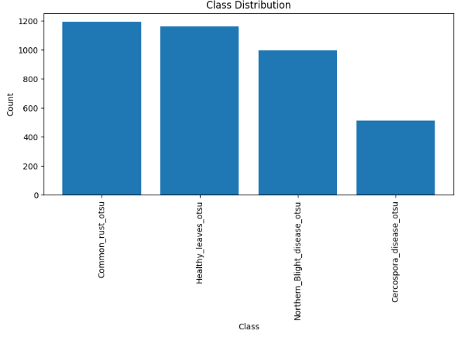
Data Visualization
01
Bar Chart: Class Distribution

Slide 24
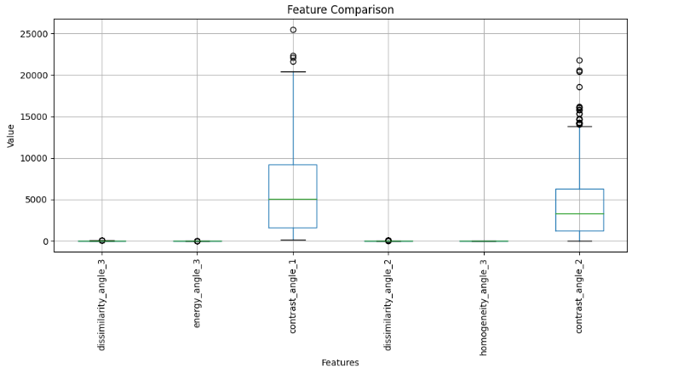
Data Visualization
02
Box Plot: Feature Comparison

Slide 25
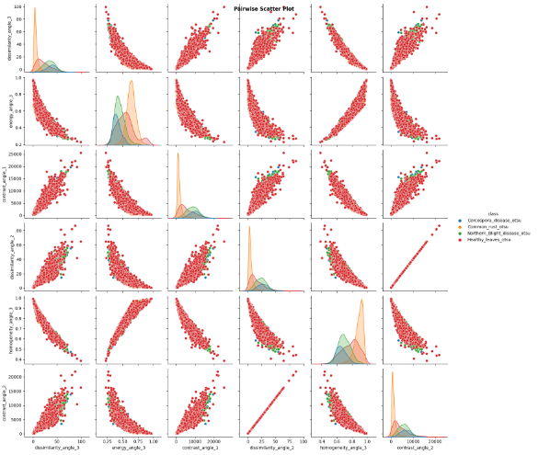
Data Visualization
03
Box Plot: Feature Comparison

Slide 26
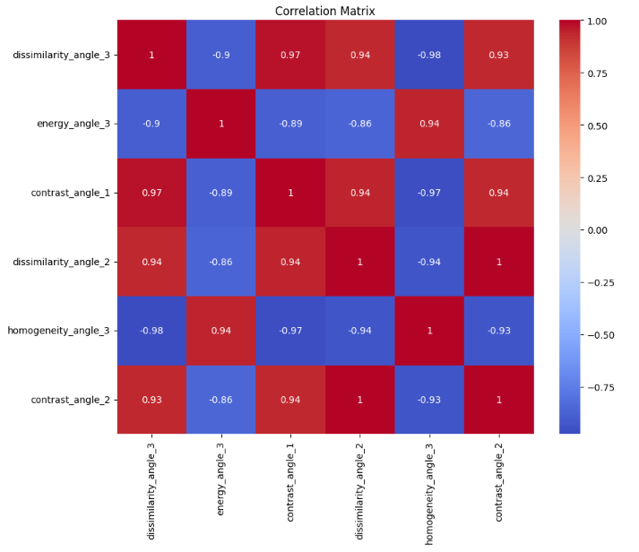
Correlation Matrix
There is a strong positive correlation between dissimilarity_angle_3 and contrast_angle_1 (0.969824), as well as between dissimilarity_angle_2 and contrast_angle_2 (0.999966).
There is a strong negative correlation between dissimilarity_angle_3 and energy_angle_3 (-0.895174), as well as between homogeneity_angle_3 and energy_angle_3 (-0.939185).

Slide 27
05
Results

Slide 28
Models Used
01
02
03
04
05
CNN
ANN
Random Forest
SVM
Decision Tree

Slide 29
CNN
Convolutional Neural Networks (CNN) are a class of deep learning models designed specifically for image and video processing tasks.
Convolution layer
Activation layer
Pooling layer
Fully Connected layer
Activation Function
Loss Function
Evaluation Metric
'relu' is used as the activation function in the convolutional and fully connected layers
categorical_crossentropy' is employed for multi-class classification problems.
'accuracy' is chosen as the metric to evaluate the model's performance during training.

Slide 30
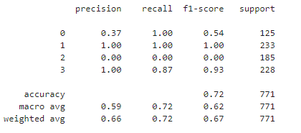
Resuts
Accuracy
Accuracy of CNN model is 72%.
F1-Score
Weighted average f1-score of all four classes is 67%.
Best Predicted
Common_rust and Northern Blight are Classified with precission 100%.

Slide 31
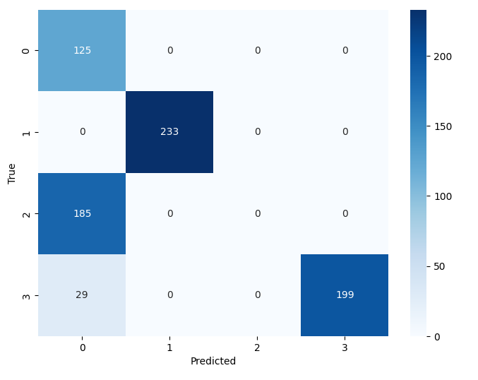
Confusion Matrix for CNN Model
125 instances were correctly classified as Cercospora Leaves.
233 instances were correctly classified as Common Rust Leaves.
0 instances were correctly classified as Healthy Leaves.
199 instances were correctly classified as Northern Blight Leaves.

Slide 32
2. ANN
Artificial Neural Networks (ANN) are computational models inspired by the structure and functioning of biological neural networks.
Input layer
Hidden layer
Output layer
Activation Function
Loss Function
Evaluation Metric
'relu' is used as the activation function in the first layer, while 'softmax' is used in the final layer for multi-class classification.
categorical_crossentropy' is employed for multi-class classification problems.
'accuracy' is chosen as the metric to evaluate the model's performance during training.

Slide 33
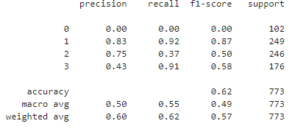
Resuts
Accuracy
Accuracy of ANN model is 62%.
F1-Score
Weighted average f1-score of all four classes is 57%.
Best Predicted
Common_rust is Classified with precission 83%.

Slide 34
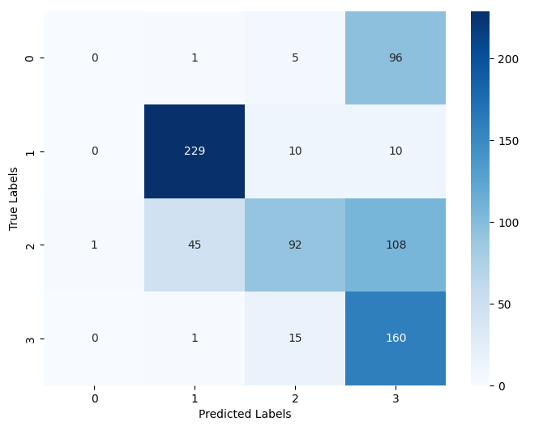
Confusion Matrix for ANN Model
0 instances were correctly classified as Cercospora Leaves.
229 instances were correctly classified as Common Rust Leaves.
92 instances were correctly classified as Healthy Leaves.
160 instances were correctly classified as Northern Blight Leaves.

Slide 35
3. Random Forest
Random Forest is an ensemble learning algorithm that combines multiple decision trees to make predictions.
Load data
Split data
Train Model
Predict
Class
Evaluation Metric
Classification Report:
The classification_report provides a summary of various evaluation metrics, including precision, recall, F1-score, and support for each class. It helps assess the performance of the model.

Slide 36
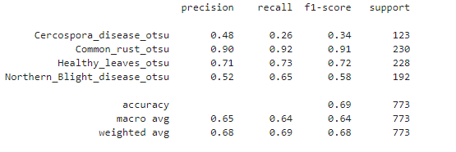
Resuts
Accuracy
Accuracy of Random Forest model is 69%.
F1-Score
Weighted average f1-score of all four classes is 68%.
Best Predicted
Common_rust is Classified with precission 90%.

Slide 37
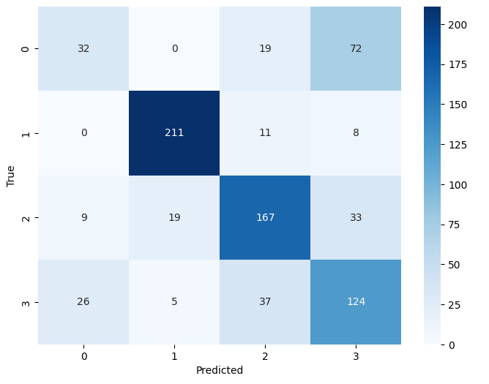
Confusion Matrix for Random Forest
32 instances were correctly classified as Cercospora Leaves.
211 instances were correctly classified as Common Rust Leaves.
167 instances were correctly classified as Healthy Leaves.
124 instances were correctly classified as Northern Blight Leaves.

Slide 38
4. SVM
SVM finds an optimal hyperplane that maximally separates different classes in the feature space.
Load feature data
Split data
Train SVM Model
PredictClass
Evaluation Metric
Classification Report:
The classification_report provides a summary of various evaluation metrics, including precision, recall, F1-score, and support for each class. It helps assess the performance of the model.

Slide 39
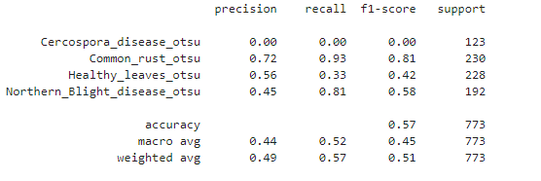
Resuts
Accuracy
Accuracy of SVM model is 57%.
F1-Score
Weighted average f1-score of all four classes is 51%.
Best Predicted
Common_rust is Classified with precission 72%.

Slide 40
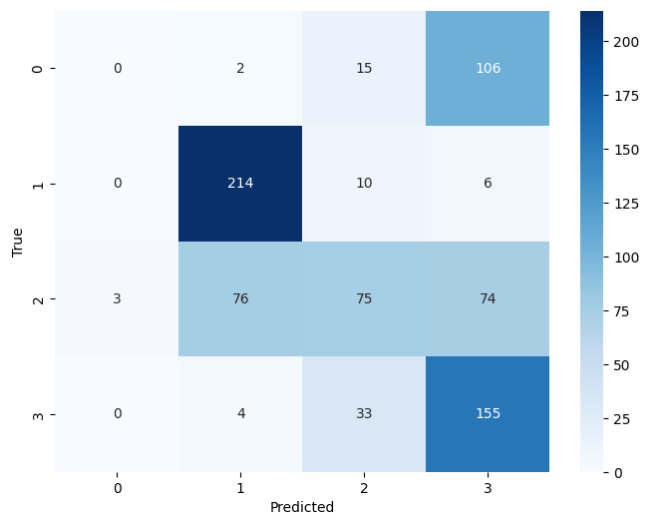
Confusion Matrix for SVM
0 instances were correctly classified as Cercospora Leaves.
214 instances were correctly classified as Common Rust Leaves.
75 instances were correctly classified as Healthy Leaves.
155 instances were correctly classified as Northern Blight Leaves.

Slide 41
5. Decision Tree
Decision Trees are a popular supervised machine learning algorithm used for both classification and regression tasks. They mimic the human decision-making process by creating a tree-like model of decisions and their possible consequences.
Build Tree
Select best feature
Split based on feature
Stops when Max depth reached
Evaluation Metric
Classification Report:
The classification_report provides a summary of various evaluation metrics, including precision, recall, F1-score, and support for each class. It helps assess the performance of the model.

Slide 42
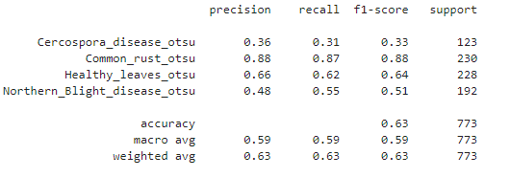
Resuts
Accuracy
Accuracy of Decision Tree model is 63%.
F1-Score
Weighted average f1-score of all four classes is 63%.
Best Predicted
Common_rust is Classified with precision 88%.

Slide 43
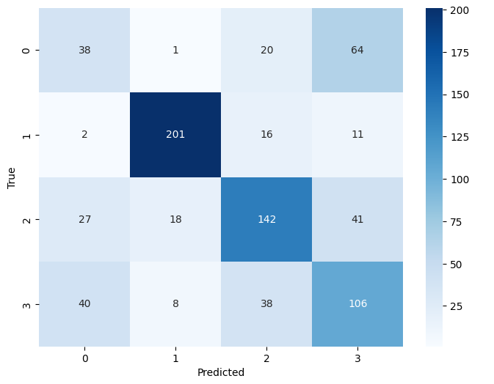
Confusion Matrix for Decission Tree
38 instances were correctly classified as Cercospora Leaves.
201 instances were correctly classified as Common Rust Leaves.
142 instances were correctly classified as Healthy Leaves.
106 instances were correctly classified as Northern Blight Leaves.

Slide 44
06
Conclusions

Slide 45
Conclusions
Among the evaluated models, CNN performed the best, followed by Random Forest, Decision Tree, and SVM.
CNN showed the highest accuracy, demonstrating its ability to effectively classify leaf diseases.
Further optimization and fine-tuning of the models can potentially improve their overall performance.

Slide 46
THANKS!

